Slide 1

Exploratory Data Analysis
Bank Marketing Project

Slide 2

Agenda
Introduction
Executive Summary
Problem Statement
Approach
EDA with Summary
Recommendations
Model Recommendation

Slide 3

Executive Summary
Farmers cooperative bank wants to sell their brand-new term deposit plans to its customers. The bank aims to do a marketing campaign to attract its customers.
To determine the potential buyers, analysis has been performed based on the existing customer database held by the bank to comprehensively conditions to take a better final decision

Slide 4

Problem Statement
Assess the customers based on previous campaign history, strategize and conclude potential customer that are likely to subscribe to term deposit and then do a marketing campaign on these potential buyers so that the bank can minimize campaign costs and maximize revenues

Slide 5
Approach
Our approach to addressing our problem statement can be divided into the following ways
Initial data analysis
Investigating the data and generating insights through EDA
Summarizing EDA Results
Concluding on the Evidences and Recommendation

Slide 6
Term Deposit Subscription by Job Analysis
Key Findings:
Primary Subscribers: Students and retired individuals are the primary subscribers to term deposits.
2. Notable Subscribers: Administrative professionals and unemployed individuals show significant interest in term deposits.
3. Less Inclined Subscribers: Blue-collar workers, entrepreneurs, and service sector professionals are less likely to subscribe.
The findings highlight potential areas for targeted marketing and outreach efforts.

Slide 7

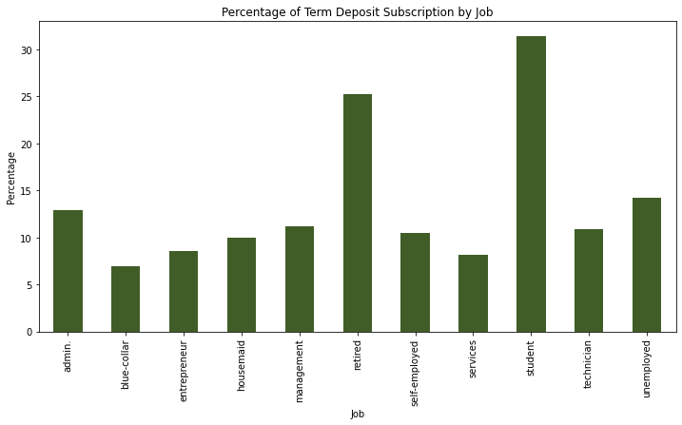

Slide 8
Implications for strategy
Tailoring marketing strategies to appeal to the preferences and needs of students and retirees could yield higher subscription rates.
Consideration should be given to understanding and addressing barriers for blue-collar workers, entrepreneurs, and service sector professionals.

Slide 9
Age Distribution Analysis
Subscriber Majority:
The majority of term deposit subscribers fall within the age group of 76-85.
This is followed by individuals aged 86 and above.
Understanding age demographics provides insights for targeted marketing and product customization.

Slide 10
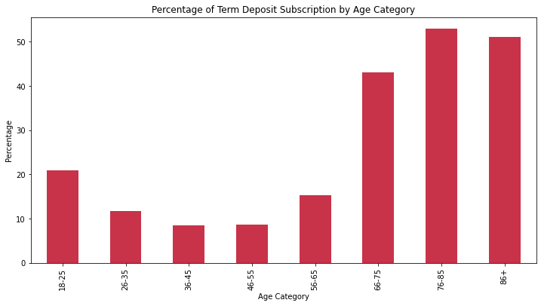

Slide 11
Impact of Contact Method on Subscription Rates
Highest Subscription Rate:
  The data reveals that the highest subscription rate occurred when customers were contacted through cellular communication.
Implications:
Cellular Communication Effectiveness: Understanding the success of cellular communication emphasizes its effectiveness in promoting term deposit subscriptions.

Slide 12
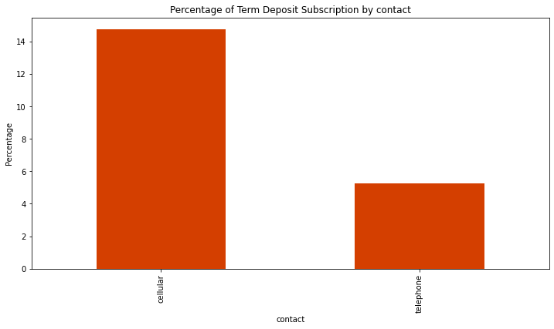
Conclusion:
Recognizing the impact of contact methods aids in refining future outreach strategies.
Consideration should be given to prioritizing or optimizing cellular communication in marketing efforts.

Slide 13
Impact of Telemarketing Campaign by Month
Highest Subscription Month:
  March demonstrated the highest number of term deposit subscriptions, with 276 individuals subscribing out of 546 customers contacted.
Implications:
Telemarketing Success in March:
  The notably high subscription rate in March suggests a successful telemarketing campaign during that period.
Conclusion:
Strategic Consideration:
  Targeting customers during March may prove particularly effective for encouraging term deposit subscriptions.
  This insight can inform the timing of future marketing campaigns.

Slide 14
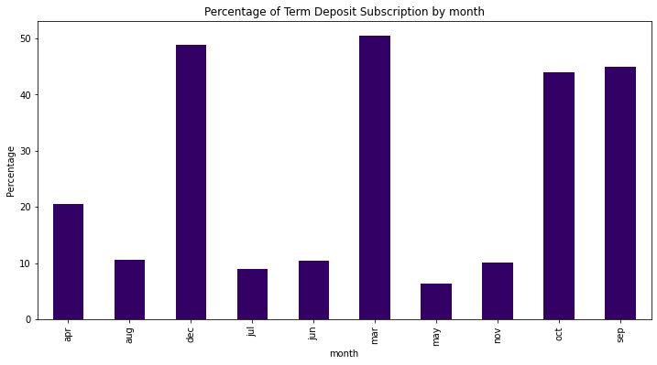

Slide 15
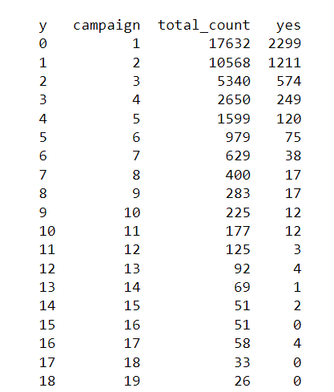
Campaign Impact on Term Deposit Subscriptions

Slide 16
Total Contacted:
  The table provides a breakdown of subscription counts based on the number of times customers were contacted during the marketing campaign (represented by the 'campaign' column).
Successful Campaigns:
  Higher subscription rates are evident in campaigns where customers were contacted fewer times.
Key Insights from number of previous contacts

Slide 17
Conclusion:
Optimal Contact Frequency:
The data suggests that campaigns with fewer contacts tend to have higher subscription rates.
Consideration should be given to optimizing contact frequency for future campaigns

Slide 18
Marital Status Impact on Term Deposit Subscriptions
Dominant Subscriber Group:
Married individuals constitute the majority of subscribers to the term deposit product.
Married Individuals:
Highest number of subscribers, indicating a significant impact on term deposit subscriptions.

Slide 19
Conclusion:
Subscriber Distribution Insights:
Understanding the distribution across marital statuses helps in tailoring marketing strategies.
Married individuals are the primary target group for term deposit subscriptions.

Slide 20
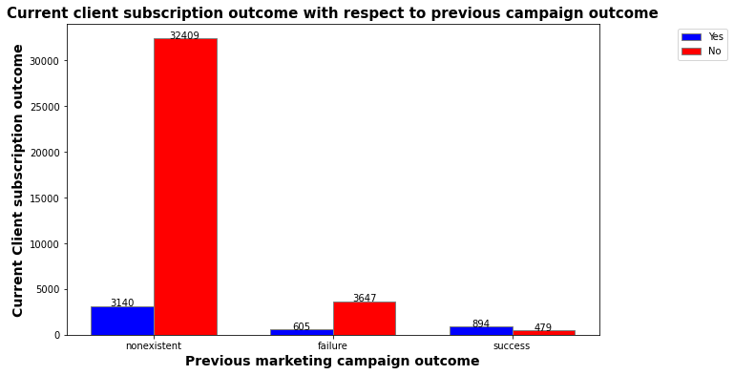
Previous Campaign impact on Term Deposit Subscription
Previous customers seem to have subscribed to current plan as well
Most of the customers who were not part of the previous campaign did not subscribe to the term deposit
Most customers who did not subscribe previously did not yield current campaign as well

Slide 21
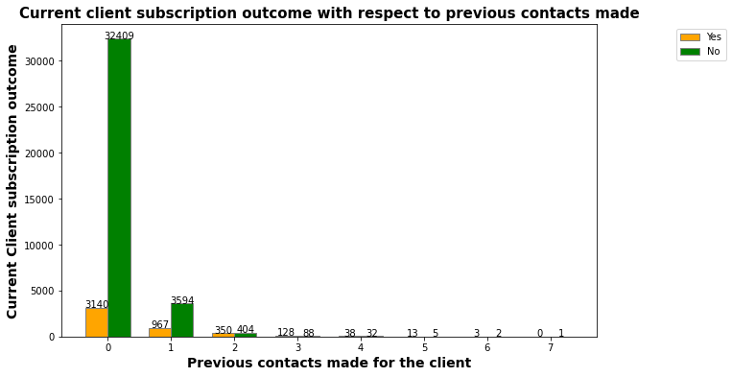
Previous Contact impact on Term Deposit Subscription
0 to 7 contacts were made with the client previously
Most of the clients were never contacted previously and most of those clients did not subscribe to the plan even now
More the calls, most likely are the customers to subscribe to the plan

Slide 22
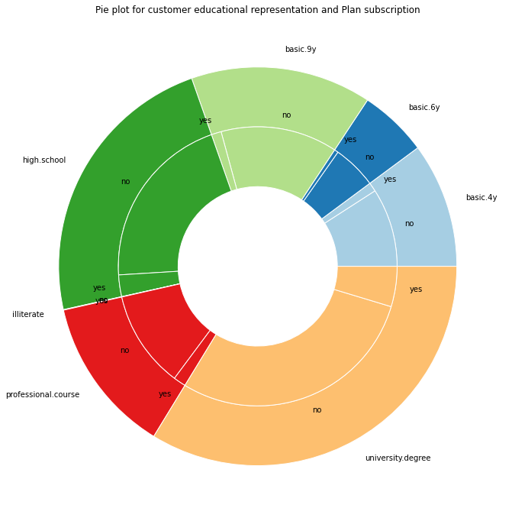
Customer Education impact on Term Deposit Subscription
There are 7 categories of educational qualification accomplished by the customers and there are more customers with university degree
the pattern suggests that only 1/5 of the customers are subscribing to the plan irrespective of the educational qualification

Slide 23
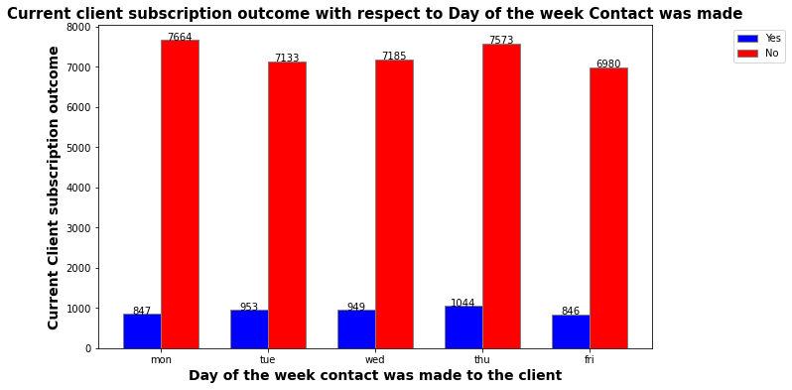
Contact Day impact on Term Deposit Subscription
Tuesday, Wednesday and Thursday have a little better chance of customers subscribing than Monday and Friday
However, the effect seem to be minimal and subscription rate is nearly the same for all days

Slide 24
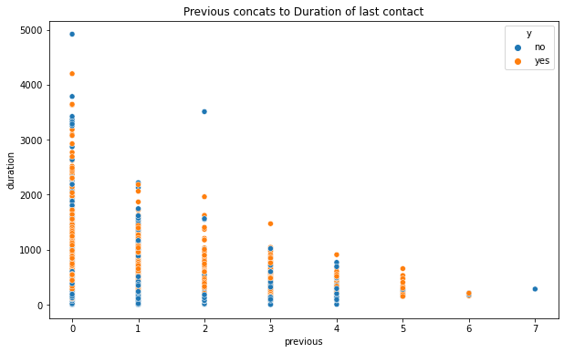
Contact duration impact on Term Deposit Subscription
With more previous contacts made with the customer, the duration of the call is largely getting reduced
Clients with no previous calls are extending the call duration to until 4000 seconds and customers with more previous calls are subscribing to the plan a lot better

Slide 25
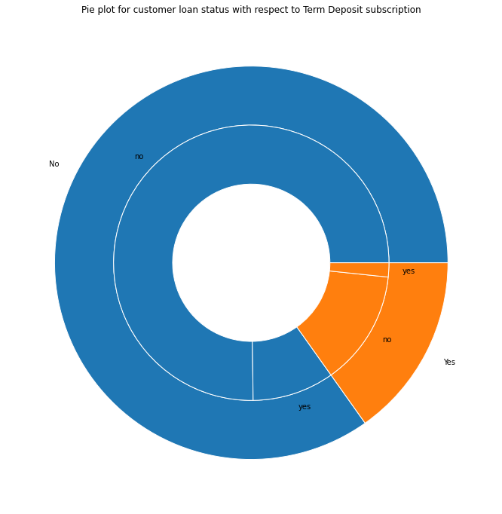
Loan Status impact on Term Deposit Subscription
Most of the customers do not have a loan
Most of the customers without loan too have not subscribed to the plan
The ratio between customers who subscribed and customers who did not subscribe with respect to having or not having a loan remains to be the same

Slide 26
Recommendations
Employment: Students and retired individuals are greatly subscribing to the deposit, bank should focus to improve on customers with other employment types as well
Age: Elder people are greatly subscribing to the deposit and the bank should invest to attract young people.
Contact Type: Cellular way of contact is getting more attention from public, and telephone should be targeted only to selected individuals.
Previous contact: The bank is successful to some extent in retaining customers but should focus on bringing in new customers.
Campaign Month: Months like March, October, September, and December are attracting more customers. The bank should do more campaigns in these months.
Number of contacts: More campaigning and more contacts did not greatly help. The bank should focus on making a better first impression.

Slide 27
Recommendations
Marital status: More singles are subscribing to the plan and the bank needs to attract the other set of customers like divorced and married.
Previous Outcome: More than half of the customers who have subscribed through a previous campaign have subscribed to the current plan too. The bank needs to focus more on these people.
Customer Education: Most of the clients contacted had a university degree. The bank should provide more incentives to attract these customers.
Contact day: There is a slight edge to attract customers on Tuesday, Wednesday, and Thursday. Therefore, the bank might need to focus more on core weekdays.
Contact duration: Customers are spending less time on call when contacted more than once. The bank should try to maximize the possibilities in subscribing to the deposit on the first call.
Loan Status: The bank should not discriminate against clients having a loan because the data clearly shows no difference on the possibilities for people with or without a loan.

Slide 28
Model Selection and Building
We have built models on our dataset with and without using the duration column. Our models include Decision Tree as the base model, Logistic Regression for linear models, Naïve Bayes for classification, KNN for non-linear models, Random Forest for ensemble models, and ADABoost for boosting models.

Slide 29
Without Duration Column:
Base Model: Decision Tree
Accuracy: 83.69%
Classification Model: Naïve Bayes
Accuracy: 21.53%
Linear Model: Logistic Regression
Accuracy: 89.65%
Non-Linear Model: KNN
Accuracy: 89.11%
Ensemble Model: Random Forest
Accuracy: 89.15%
Boosting Model: ADABoost
Accuracy: 89.39%
Except for Naïve Bayes, all other models perform significantly better. Logistic Regression has the highest accuracy.

Slide 30
Considering Duration Column in the Model:
Base Model: Decision Tree
Accuracy: 88.19%
Classification Model: Naïve Bayes
Accuracy: 37.47%
Linear Model: Logistic Regression
Accuracy: 90.43%
Non-Linear Model: KNN
Accuracy: 89.87%
Ensemble Model: Random Forest
Accuracy: 91.34%
Boosting Model: ADABoost
Accuracy: 91.07%

Slide 31
Random Forest has the highest accuracy when the duration column is included in the features. There is a considerable increase in the accuracy of the Decision Tree. Naïve Bayes still performs poorly. Random Forest, ADABoost, and Logistic Regression show considerable improvement after including the duration column.

Slide 32
Model Evaluation
The Naïve Bayes classification model shows poor performance and is not recommended for use. While the Decision Tree demonstrates satisfactory results, Logistic Regression and Random Forest outperform it. KNN does not exhibit significant improvement after including the duration column. Notably, Random Forest, ADABoost, and Logistic Regression show considerable enhancement when the duration column is considered.

Slide 33
Final Recommendation
Considering higher accuracy and consistent performance, we recommend adopting Random Forest as the final model. Its robust performance remains unaffected by the inclusion or exclusion of the duration column

